Slide 1
FULL STACK WEB DEVELOPMENT
NAME – PIYUSH
UNIVERSITY ROLL NUMBER : 2300290100171
CSE 3_C 2023-27 BATCH
PRESENTATION FOR MLSA

Slide 2



TECH STACK USED
HTML (Hyper Text Markup Language) is the standard language for creating web pages. It uses tags to structure content.
CSS (Cascading Style Sheets) is a styling language used to define the look and layout of HTML elements on a webpage.
JavaScript is a versatile, high-level programming language primarily used to add interactivity and dynamic content to websites.

Slide 3
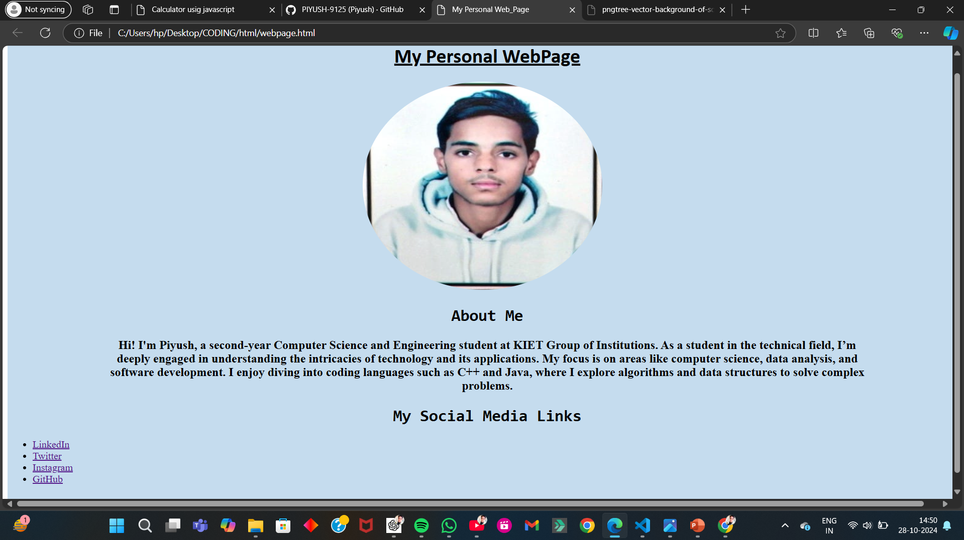
Easy Project : Personal Webpage using HTML

Slide 4
Feature considering while creating a personal webpage.
Name/Title: A prominent display of your name or a personal tagline.
Navigation Menu: Links to different sections of the page (e.g., About, Projects, Contact).
Bio: A brief introduction about yourself, including your background, interests, and what you do.
Profile Picture: A personal photo to make the page more relatable.
Showcase of Work: Thumbnails or links to projects you’ve worked on, possibly with descriptions.
Skills: A list of your skills or technologies you’re proficient in, potentially with visual indicators (e.g., progress bars).

Slide 5
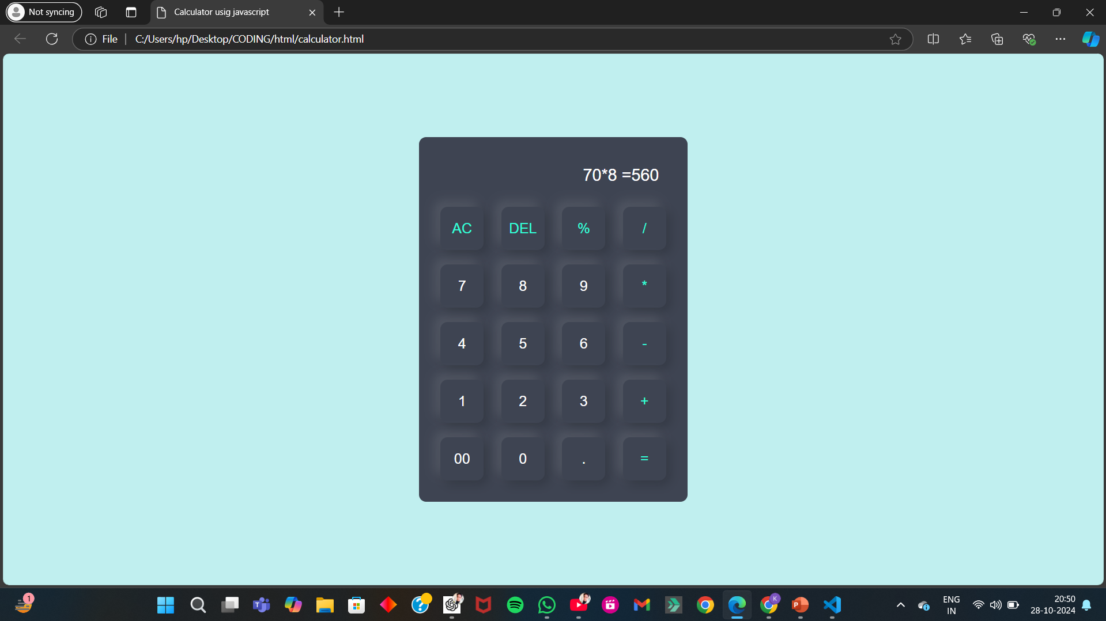
Intermediate Project : Working Calculator using JavaScript

Slide 6
JavaScript Calculator features!
Basic Math Operations: Perform addition, subtraction, multiplication, and division seamlessly.
Real-Time Calculations: See results instantly as you type.
Responsive Design: Works perfectly on both desktop and mobile devices.
Clear & Reset Options: Easily clear single entries by click on DEL button or reset the entire calculation by click on AC button .
Perfect for quick calculations and great for learning JavaScript fundamentals!

Slide 7
Thank you!

